Slide 1

Data Structuring and File Handling / COMPREHENSIVE EXAMINATION (Part 2)
Module 05

Slide 2

Outline
Working with Packages
Introduction to Classes in Python
Essentials of Python File Handling
Project Case Study and Presentation
Comprehensive Examination (Part 02)

Slide 3
Python Packages
We organize a large number of files in different folders and subfolders based on some criteria, so that we can find and manage them easily.
In the same way, a package in Python takes the concept of the modular approach to next logical level.
A module can contain multiple objects, such as classes, functions, etc.
A package can contain one or more relevant modules.
Physically, a package is actually a folder containing one or more module files.

Slide 4
Python Packages (__init__.py)
The package folder contains a special file called __init__.py, which stores the package's content.
It serves two purposes:
The Python interpreter recognizes a folder as the package if it contains __init__.py file.
__init__.py exposes specified resources from its modules to be imported.
An empty __init__.py file makes all functions from the above modules available when this package is imported.
Note that __init__.py is essential for the folder to be recognized by Python as a package.
You can optionally define functions from individual modules to be made available.

Slide 5
Python Packages (__init__.py)
The __init__.py file is normally kept empty.
However, it can also be used to choose specific functions from modules in the package folder and make them available for import.
The specified functions can now be imported in the interpreter session or another executable script.

Slide 6
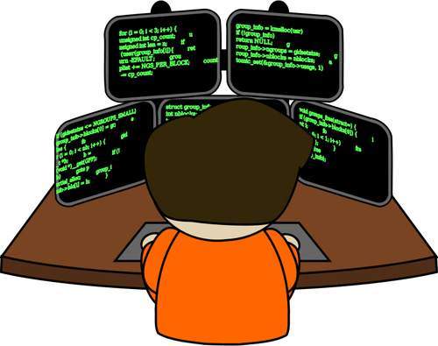
Simulation [21]
Filename Format: Simulation Day Number + Underscore + Name Initial
Sample: SimulationDay05-21_JTB.py

Slide 7

Let’s work on the problem set!!!
Filename Format: Problem Set Number + Underscore + Name Initial
Sample: PS21_JTB.py

Slide 8
Python Class
Python is a completely object-oriented language.
Every element in a Python program is an object of a class.
A number, string, list, dictionary, etc., used in a program is an object of a corresponding built-in class.
A class in Python can be defined using the class keyword.

Slide 9
Python Class
Syntax:
Class <ClassName>:
<statement1>
<statement2>
.
.
<statementN>

Slide 10
Python Class
A class is defined using the class keyword followed by the class name and : operator after the class name, which allows you to continue in the next indented line to define class members.
The followings are class members.
Class Attributes
Constructor
Instance Attributes
Properties
Class Methods
A class can also be defined without any members.

Slide 11
Python Class
Class instantiation uses function notation.
To create an object of the class, just call a class like a parameterless function that returns a new object of the class.

Slide 12
Class Attributes
Class attributes are the variables defined directly in the class that are shared by all objects of the class.
Class attributes can be accessed using the class name as well as using the objects.
Changing the value of class attribute using the class name would change it across all instances.
However, changing class attribute value using instance will not reflect to other instances or class.

Slide 13
Constructor
In Python, the constructor method is invoked automatically whenever a new object of a class is instantiated, same as constructors in C# or Java.
The constructor must have a special name __init__() and a special parameter called self.
The first parameter of each method in a class must be the self , which refers to the calling object.
However, you can give any name to the first parameter, not necessarily self.
The constructor in Python is used to define the attributes of an instance and assign values to them.

Slide 14
Class Properties
In Python, a property in the class can be defined using the property() function.
The property() method in Python provides an interface to instance attributes.
It encapsulates instance attributes and provides a property, same as Java and C#.
The property() method takes the get, set and delete methods as arguments and returns an object of the property class.

Slide 15
Class Methods
You can define as many methods as you want in a class using the def keyword.
Each method must have the first parameter, generally named as self, which refers to the calling instance.
Self is just a conventional name for the first argument of a method in the class.
A method defined as mymethod(self, a, b) should be called as x.mymethod(a, b) for the object x of the class.

Slide 16
Simulation [22]
Filename Format: Simulation Day Number + Underscore + Name Initial
Sample: SimulationDay05-22_JTB.py

Slide 17
Let’s work on the problem set!!!
Filename Format: Problem Set Number + Underscore + Name Initial
Sample: PS22_JTB.py

Slide 18
Python File I/O - Read and Write Files
In Python, the IO module provides methods of three types of IO operations; raw binary files, buffered binary files, and text files.
The canonical way to create a file object is by using the open() function.

Slide 19
Python File I/O - Read and Write Files
Any file operations can be performed in the following three steps:
Open the file to get the file object using the built-in open() function. There are different access modes, which you can specify while opening a file using the open() function.
Perform read, write, append operations using the file object retrieved from the open() function.
Close and dispose the file object.

Slide 20
Reading File
File object includes the following methods to read data from the file.
read(chars): reads the specified number of characters starting from the current position.
readline(): reads the characters starting from the current reading position up to a newline character.
readlines(): reads all lines until the end of file and returns a list object.

Slide 21
Writing File
The file object provides the following methods to write to a file.
write(s): Write the string s to the stream and return the number of characters written.
writelines(lines): Write a list of lines to the stream.
Each line must have a separator at the end of it.

Slide 22
Simulation [23]
Filename Format: Simulation Day Number + Underscore + Name Initial
Sample: SimulationDay05-23_JTB.py

Slide 23
Let’s work on the problem set!!!
Filename Format: Problem Set Number + Underscore + Name Initial
Sample: PS23_JTB.py

Slide 24
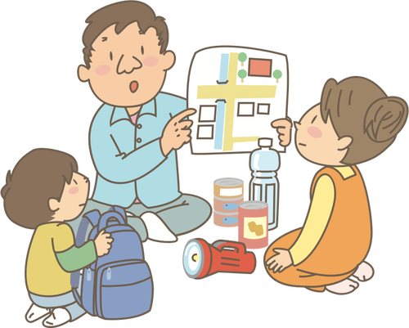
Trainer’s Tips 09:
Nurturing Novices
"Nurture Novices" suggests that an effective trainer should focus on nurturing or guiding beginners or newcomers in a particular subject or skill. It implies fostering a supportive environment, providing guidance, and helping novices develop their skills or knowledge effectively.

Slide 25
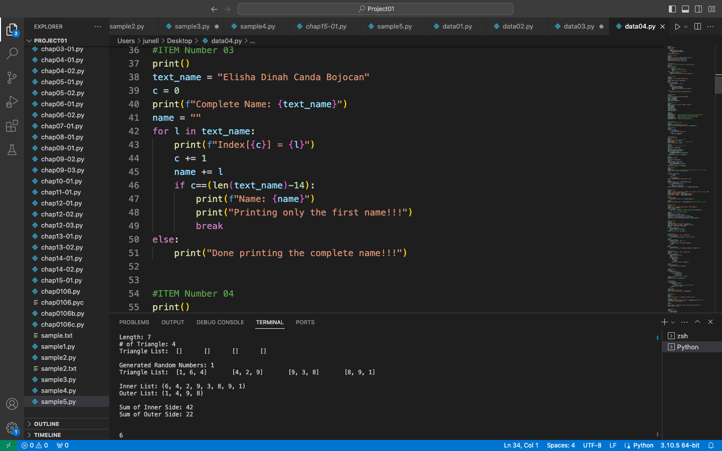
Trainer’s Tips 10:
Ten Thousand At Least
To become proficient in python and excel as an effective trainer, aim to write at least ten thousand lines of python code. Mastery in coding often emerges from the dedication to crafting an extensive amount of code, where consistent practice not only hones your skills but also deepens your understanding of python's capabilities.

Slide 26
In a nutshell…
COMMITMENT
C - Content Control
O - Organized Material
M - Monitor Messages
M - Mastery Check
I - Instill Values
T - Timed Delivery
M - Modify as Needed
E - Engage Effectively
N - Nurturing Novices
T - Ten Thousand Lines At Least

Slide 27
Sources:
https://www.python.org/downloads/
https://youtu.be/i-MuSAwgwCU
https://classroom.google.com/c/NTE5NzI3NDA3NTU1/m/NjA4MjI3MDEwMTc5/details
https://youtu.be/VC13MkENVoY
https://youtu.be/GenKovl05YU
https://youtu.be/riL_xn6BKD8
https://youtu.be/_uQrJ0TkZlc
https://docs.python.org/3/tutorial/index.html
https://www.pythontutorial.net/
https://www.programiz.com/python-programming
https://www.tutorialsteacher.com/python
https://www.tutorialspoint.com/python/index.htm
https://www.w3schools.com/python/
https://www.onlinegdb.com/
https://improveandrepeat.com/2020/07/python-friday-30-list-comprehension/
https://intellipaat.com/blog/tutorial/python-tutorial/?US

Slide 28
Thank you…

